Slide 1
Objectives
In this session, you will learn to:
  Appreciate SQL Server 2005 as a database server
  Identify the SQL Server 2005 tools

Slide 2
Features of SQL Server 2005
SQL Server 2005 provides the following features:
  Built-in support for Extensible Markup Language (XML) data
  CLR integration
  Scalability
  Service-oriented architecture
  Support for Web services
  High level of security
  High availability
  Support for data migration and analysis

Slide 3
SQL
Is the core language used to store, access, and modify data.
Can be categorized as:
  Data Definition Language (DDL):
    Is used to define the database, data types, structures, and constraints on the data.
  Data Manipulation Language (DML):
    Is used to manipulate the data in the database objects.
  Data Control Language (DCL):
    Is used to control the data access in the database.
  Data Query Language (DQL):
    Is used to query data from the database objects.
Notes:
Emphasize on the fact that most DBMS have created customized versions of the SQL language. For example, Transact-SQL (T-SQL) is a scripting language used on the SQL Server for programming. Alternatively, PL-SQL is used for programming in Oracle. T-SQL confirms to the ANSI SQL-92 standard published by ANSI and ISO in the year 1992.

Slide 4
SQL (Contd.)
  Some of the DDL statements are:
    CREATE
    ALTER
    DROP
  Some of the DML statements are:
    INSERT
    UPDATE
    DELETE
  Some of the DCL statements are:
    GRANT
    REVOKE
Notes:
Emphasize on the fact that most DBMS have created customized versions of the SQL language. For example, Transact-SQL (T-SQL) is a scripting language used on the SQL Server for programming. Alternatively, PL-SQL is used for programming in Oracle. T-SQL confirms to the ANSI SQL-92 standard published by ANSI and ISO in the year 1992.

Slide 5
Just a minute
Which of the following features of SQL Server 2005 allow the developers to implement their programming logic in any language supported by the .NET Framework?
  Support for data migration
  High availability
  CLR integration
  Scalability
Answer:
  3. CLR integration

Slide 6

Identifying SQL Server 2005 Tools
Before you start working on SQL Server 2005, it is important to identify various tools provided by the server and their features.
Notes:
Student already have learnt about type 2 SCDs in Module I. Therefore, you can start this topic by asking the following questions to students:
What are type 2 SCDs?
Given an example to explain type 2 SCDs.
This will recapitulate what they have learnt about type 2 SCD in Module 1.
Now explain the strategy to update the data into these dimension tables with help the example given in SG.
After explaining the examples, you can ask students to think of an example of a type 2 SCD and then tell the strategy to update the data into this dimension table.

Slide 7
SQL Server Management Studio
  Is a powerful tool associated with SQL Server 2005.
  Provides a simple and integrated environment for developing and managing the SQL Server database objects.
Notes:
Student already have learnt about type 2 SCDs in Module I. Therefore, you can start this topic by asking the following questions to students:
What are type 2 SCDs?
Given an example to explain type 2 SCDs.
This will recapitulate what they have learnt about type 2 SCD in Module 1.
Now explain the strategy to update the data into these dimension tables with help the example given in SG.
After explaining the examples, you can ask students to think of an example of a type 2 SCD and then tell the strategy to update the data into this dimension table.

Slide 8
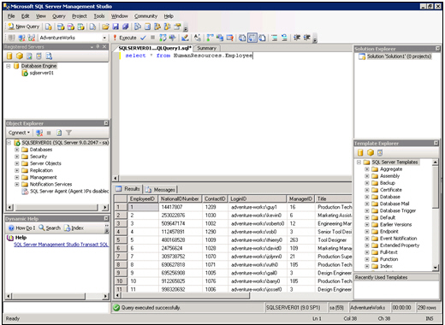
SQL Server Management Studio (Contd.)
  The following figure shows the SQL Server Management Studio interface.
Registered Servers
Solution Explorer
Query Editor
Object Explorer
Template Explorer
Dynamic Help
Notes:
Student already have learnt about type 2 SCDs in Module I. Therefore, you can start this topic by asking the following questions to students:
What are type 2 SCDs?
Given an example to explain type 2 SCDs.
This will recapitulate what they have learnt about type 2 SCD in Module 1.
Now explain the strategy to update the data into these dimension tables with help the example given in SG.
After explaining the examples, you can ask students to think of an example of a type 2 SCD and then tell the strategy to update the data into this dimension table.

Slide 9
SQL Server Business Intelligence Development Studio
  Is a tool that provides an environment to develop business intelligence solutions.
  Contains templates, tools, and wizards to work with objects that you can use to create business intelligence solutions.
  Helps build the following types of solutions:
  Data integration
  Data analysis
  Data reporting
Notes:
Student already have learnt about type 2 SCDs in Module I. Therefore, you can start this topic by asking the following questions to students:
What are type 2 SCDs?
Given an example to explain type 2 SCDs.
This will recapitulate what they have learnt about type 2 SCD in Module 1.
Now explain the strategy to update the data into these dimension tables with help the example given in SG.
After explaining the examples, you can ask students to think of an example of a type 2 SCD and then tell the strategy to update the data into this dimension table.

Slide 10
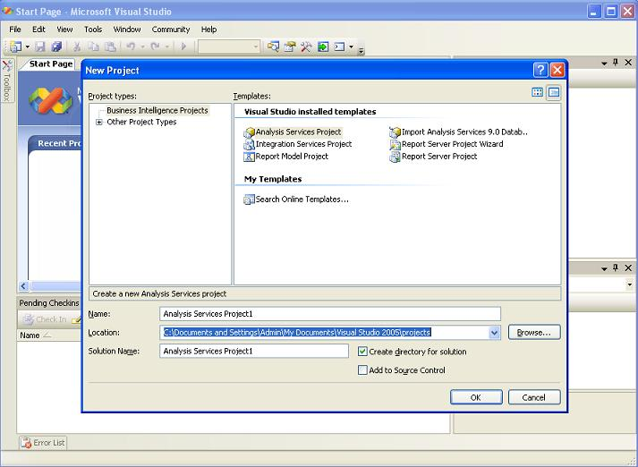
SQL Server Business Intelligence Development Studio (Contd.)
  The following figure shows the SQL Server Business Intelligence Development Studio interface.
Different project templates
Notes:
Student already have learnt about type 2 SCDs in Module I. Therefore, you can start this topic by asking the following questions to students:
What are type 2 SCDs?
Given an example to explain type 2 SCDs.
This will recapitulate what they have learnt about type 2 SCD in Module 1.
Now explain the strategy to update the data into these dimension tables with help the example given in SG.
After explaining the examples, you can ask students to think of an example of a type 2 SCD and then tell the strategy to update the data into this dimension table.

Slide 11
Database Engine Tuning Advisor
  Helps database administrators to analyze and tune the performance of the server.
  Provides recommendations to add, remove, or modify database objects, such as indexes or indexed views to improve performance.
Notes:
Student already have learnt about type 2 SCDs in Module I. Therefore, you can start this topic by asking the following questions to students:
What are type 2 SCDs?
Given an example to explain type 2 SCDs.
This will recapitulate what they have learnt about type 2 SCD in Module 1.
Now explain the strategy to update the data into these dimension tables with help the example given in SG.
After explaining the examples, you can ask students to think of an example of a type 2 SCD and then tell the strategy to update the data into this dimension table.

Slide 12
SQL Server Configuration Manager
  Helps the database administrators to manage the services associated with SQL Server.
  Allows you to manage the network connectivity configuration from the SQL Server client computers.
  Allows you to specify the protocols through which the client computers can connect to the server.
Notes:
Student already have learnt about type 2 SCDs in Module I. Therefore, you can start this topic by asking the following questions to students:
What are type 2 SCDs?
Given an example to explain type 2 SCDs.
This will recapitulate what they have learnt about type 2 SCD in Module 1.
Now explain the strategy to update the data into these dimension tables with help the example given in SG.
After explaining the examples, you can ask students to think of an example of a type 2 SCD and then tell the strategy to update the data into this dimension table.

Slide 13
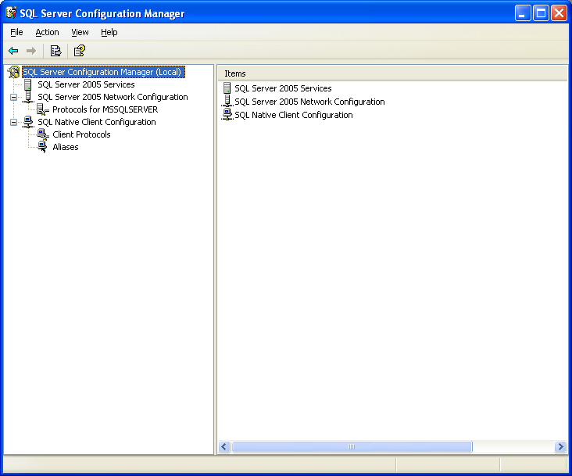
SQL Server Configuration Manager (Contd.)
  The following figure shows the SQL Server Configuration Manager interface.
Notes:
Student already have learnt about type 2 SCDs in Module I. Therefore, you can start this topic by asking the following questions to students:
What are type 2 SCDs?
Given an example to explain type 2 SCDs.
This will recapitulate what they have learnt about type 2 SCD in Module 1.
Now explain the strategy to update the data into these dimension tables with help the example given in SG.
After explaining the examples, you can ask students to think of an example of a type 2 SCD and then tell the strategy to update the data into this dimension table.

Slide 14
Just a minute
Which of the following tools of SQL Server 2005 allow starting and stopping the full-text search?
  1. SQL Server Management Studio
  2. Business Intelligence Development Studio
  3. Database Engine Tuning Advisor
  4. SQL Server Configuration Manager
Answer:
  4. SQL Server Configuration Manager

Slide 15
Summary
In this session, you learned that:
  SQL Server 2005 provides the following benefits:
    Built-in support for XML data
    CLR integration
    Scalability
    Service-oriented architecture
    Support for Web services
    High level of security
    High availability
    Support for data migration and analysis
  SQL includes:
    DDL: To create and manage database objects
    DML: To store and manage data in database objects
    DCL: To allow or deny access to database objects
    DQL: To query data from the database objects
Notes:
You can summarize the session by running through the summary given in SG.
In addition, you can also ask students summarize what they have learnt in this session.

Slide 16
Summary (Contd.)
  SQL Server 2005 provides the following tools to improve the efficiency of the database developers and manage the server:
    SQL Server Management Studio
    SQL Server Business Intelligence Management Studio
    Database Engine Tuning Advisor
    SQL Server Configuration Manager
Notes:
You can summarize the session by running through the summary given in SG.
In addition, you can also ask students summarize what they have learnt in this session.

